Slide 1
Servers, databases and software
27/04/2021

Slide 2
Hagrr
HAGR utilizes 6 main MySQL databases – DrugAge, AnAge, GenAgeHuman, GenAgeModel, CellAge and GenDR
Currently, users can download data from the various databases by downloading csv files directly from the website
This is fine, but:
The csv file is a truncated table which might not have all the columns and information the user needs
It would be nice for bioinformaticians to access the full datasets programmatically and easily integrate the data into their analysis/pipelines

Slide 3
Hagrr
HAGRR is an R data package built specifically to share these datasets with the R community
The code is currently on GitHub and available for users to download
At the moment the full datasets for CellAge, DrugAge and GenAge (human) are included in HAGRR
It allows R users to simply run remotes::install_github(”maglab/HAGRR"), and have all the data ready for any scripts they wish to run

Slide 4
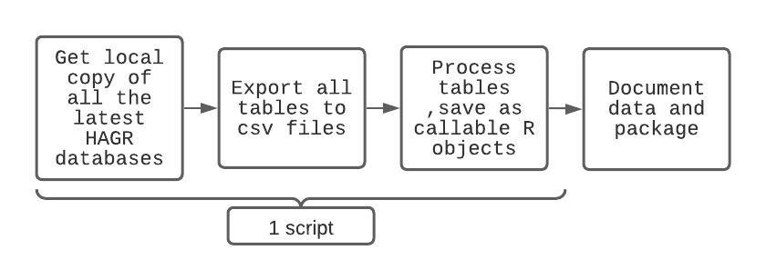
Hagrr-development workflow

Slide 5
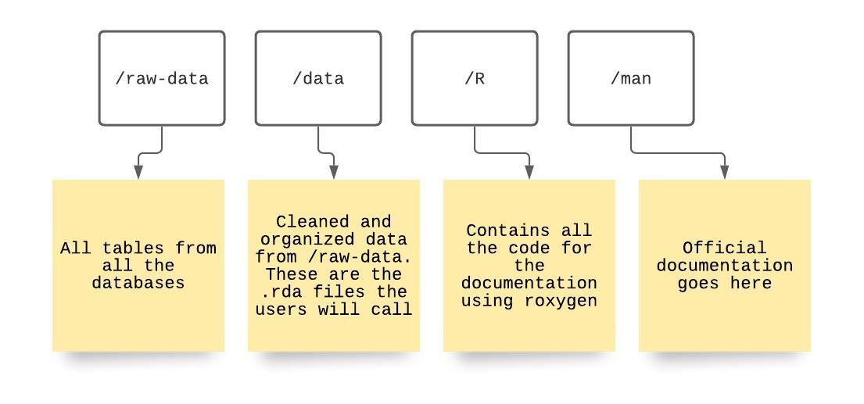
hagrr
Raw data folder has csv files of the tables ~ 9 MB. Can be cut down more – but reproducibility is important
Data folder has just the .rda files. – R is much faster at reading these files than csv files. ~ 200 KB
Documentation has description of each database, table and columns for users to reference

Slide 6
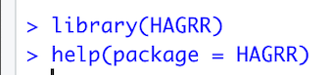
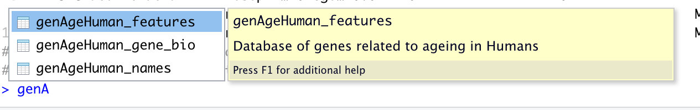
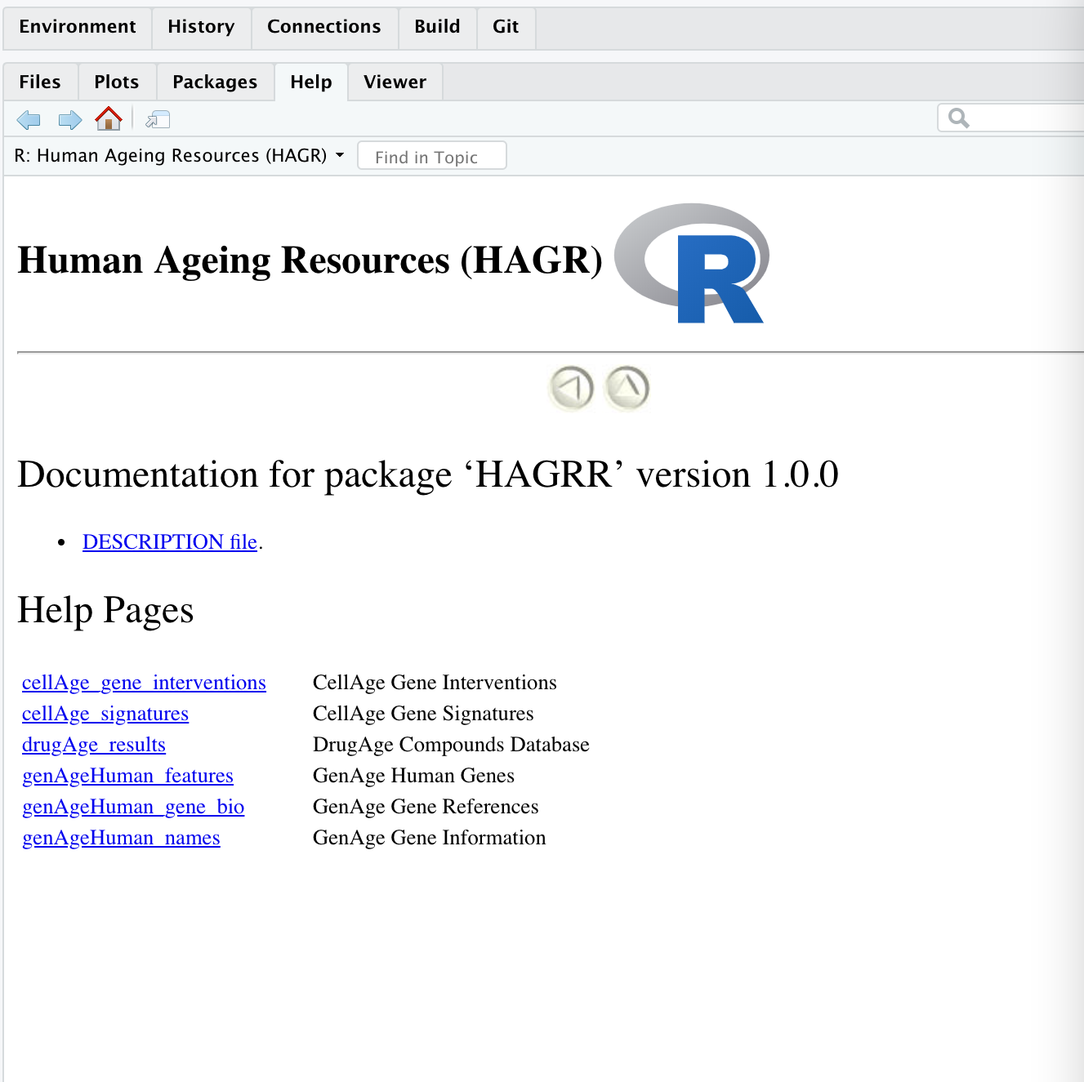
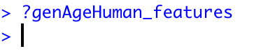
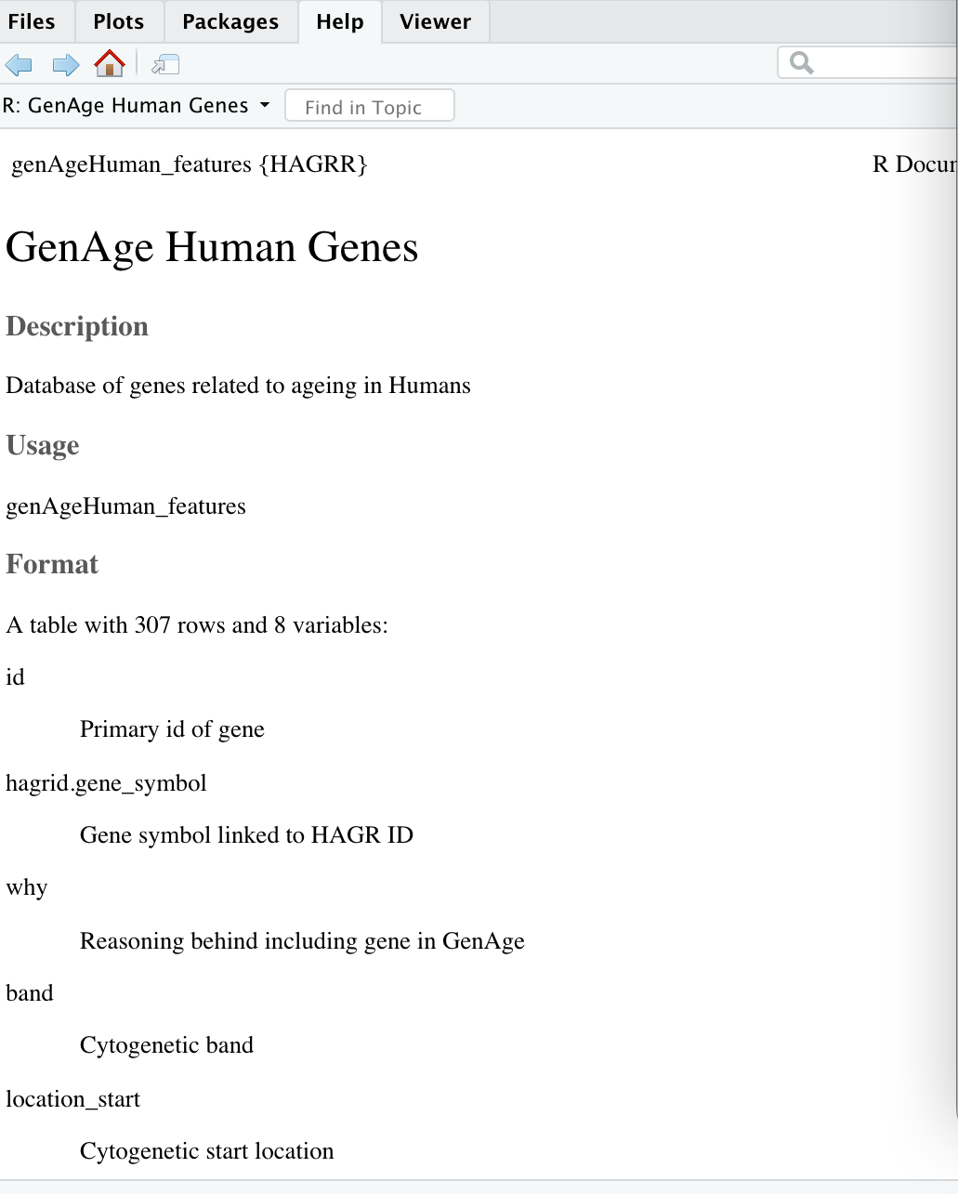

Slide 7
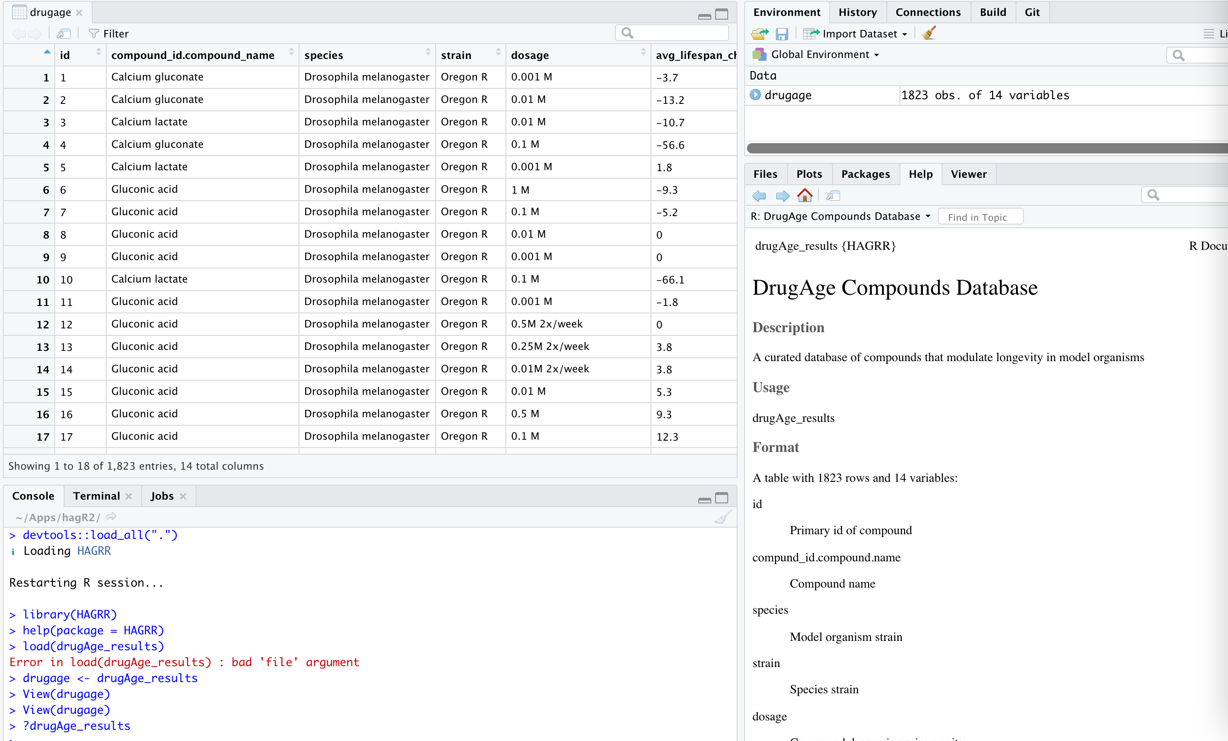

Slide 8
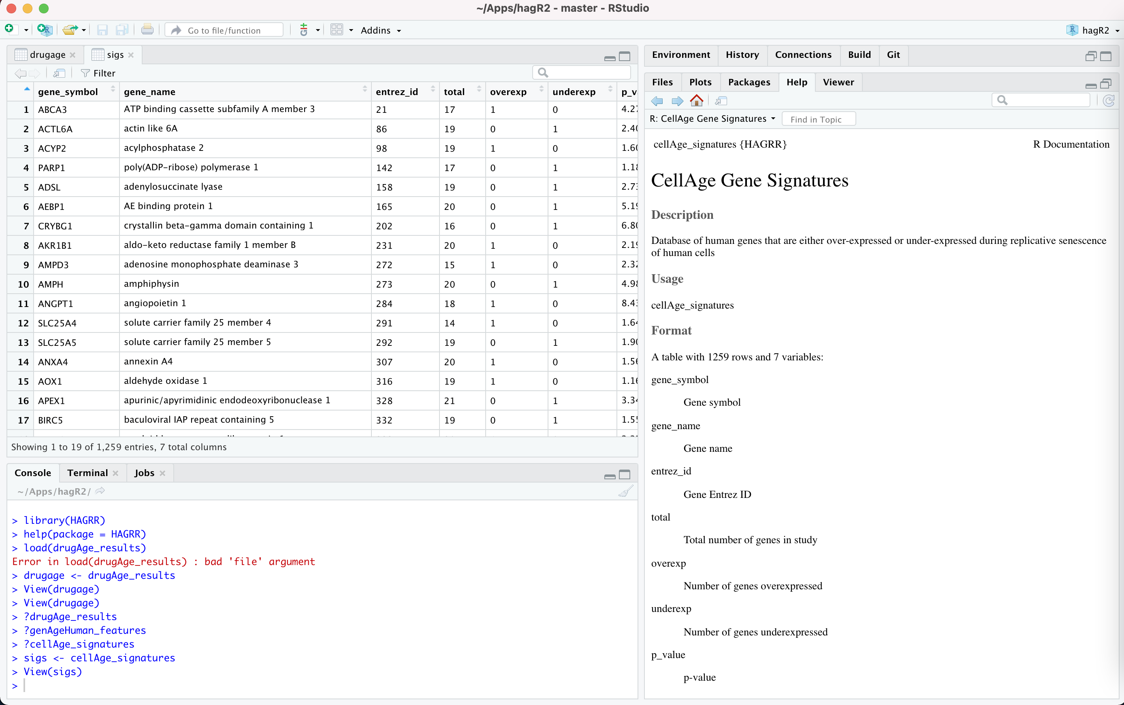
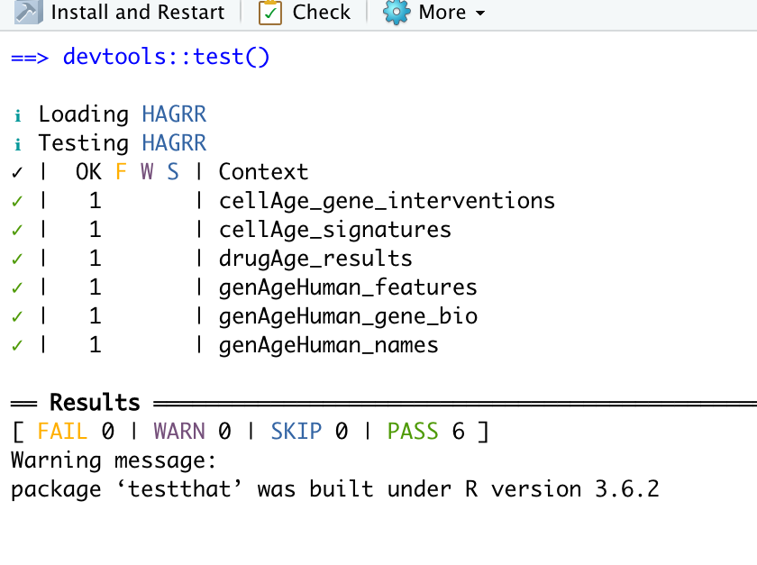

Slide 9
Hagrr- To-do and maintenance
Add AnAge, GenDR and GenAge model databases
When we update the data in HAGR:
Add the new data to /data-raw
Run load script for the database
Update documentation and release notes
Build, test and Push to GitHub
When users re-install the package they will have the updates

Slide 10
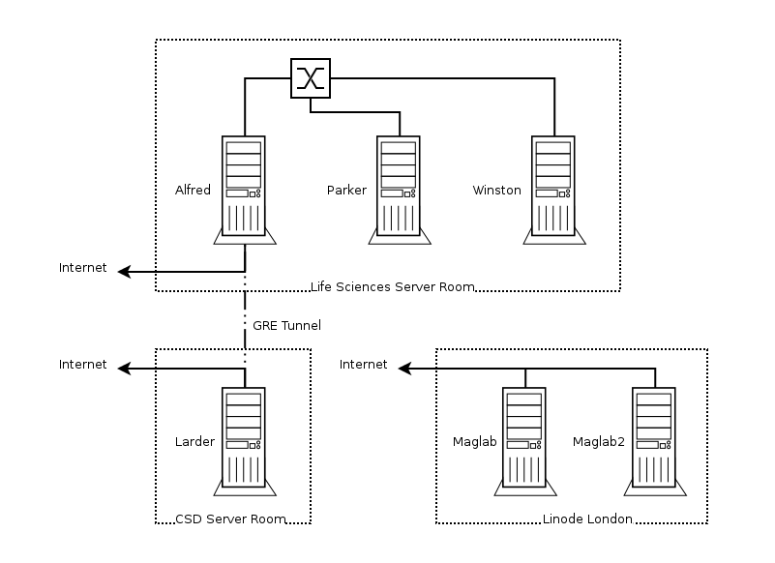
Servers
All Viglen built rack mounts running Ubuntu accessible via SSH
Larder- 66TiB disk space (28 disks + cache disk + os disk + boot disk)
Winston- All bioinformatics work
Larder- All Storage
Larder is mounted on Alfred and Winston - /base (larder:/larder/homes)
All user home directories have a ‘work’ folder which is symlinked to the larder mounted directory
All accessible over VPN, soon 2FA
Notes:
GRE - Generic routing encapsulation (GRE) is a virtual point to point link that encapsulates data traffic in a tunnel

Slide 11
servers
Few months ago, Alfred was compromised via brute force SSH attempts
Most likely by bots that were able to get in and use the processing power for bitcoin mining
CSD took it off the network. Genefriends moved to the Maglab server
It was backed up on Larder (where everyone’s data is), wiped clean and Ubuntu 20.04 installed on Alfred
Winston was given it’s own external IP address and is the new gateway into the cluster while Alfred is being reinstated
Current status: Alfred is on campus, connected to a working external port and just needs to be re-integrated into the cluster by slowly moving the config files back

Slide 12
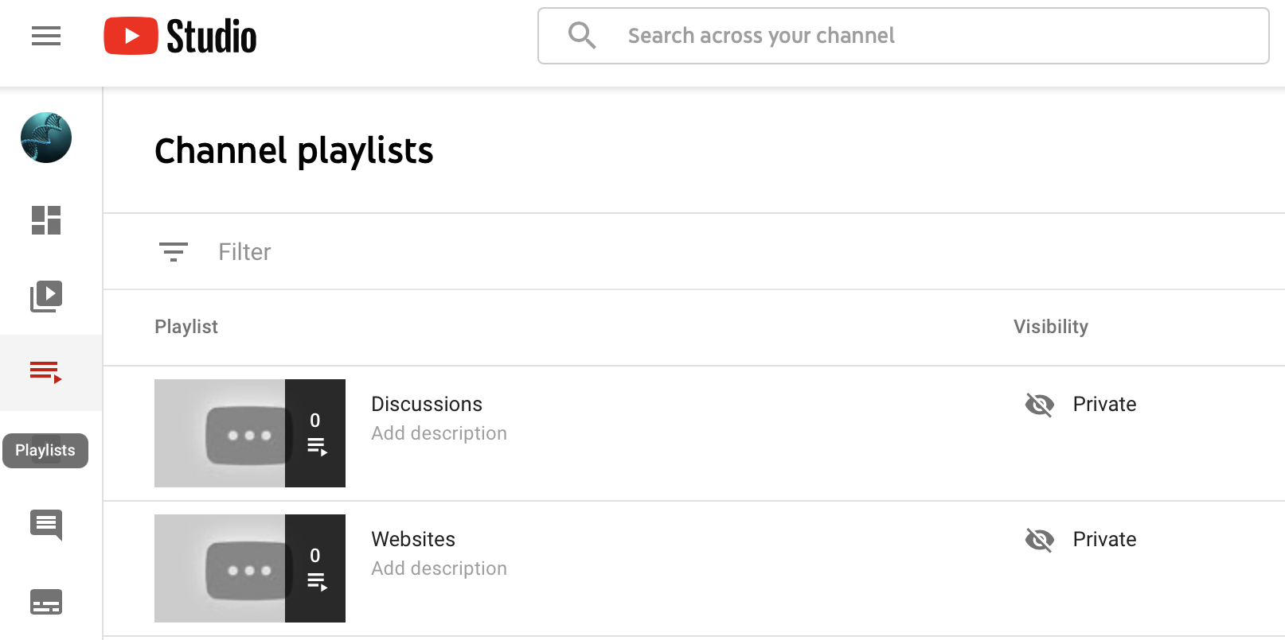
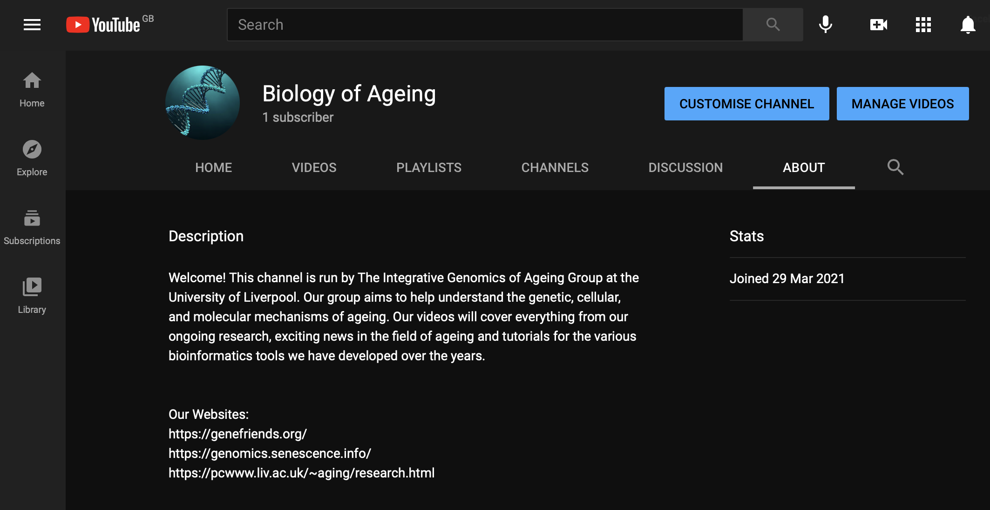
YouTube channel

Slide 13
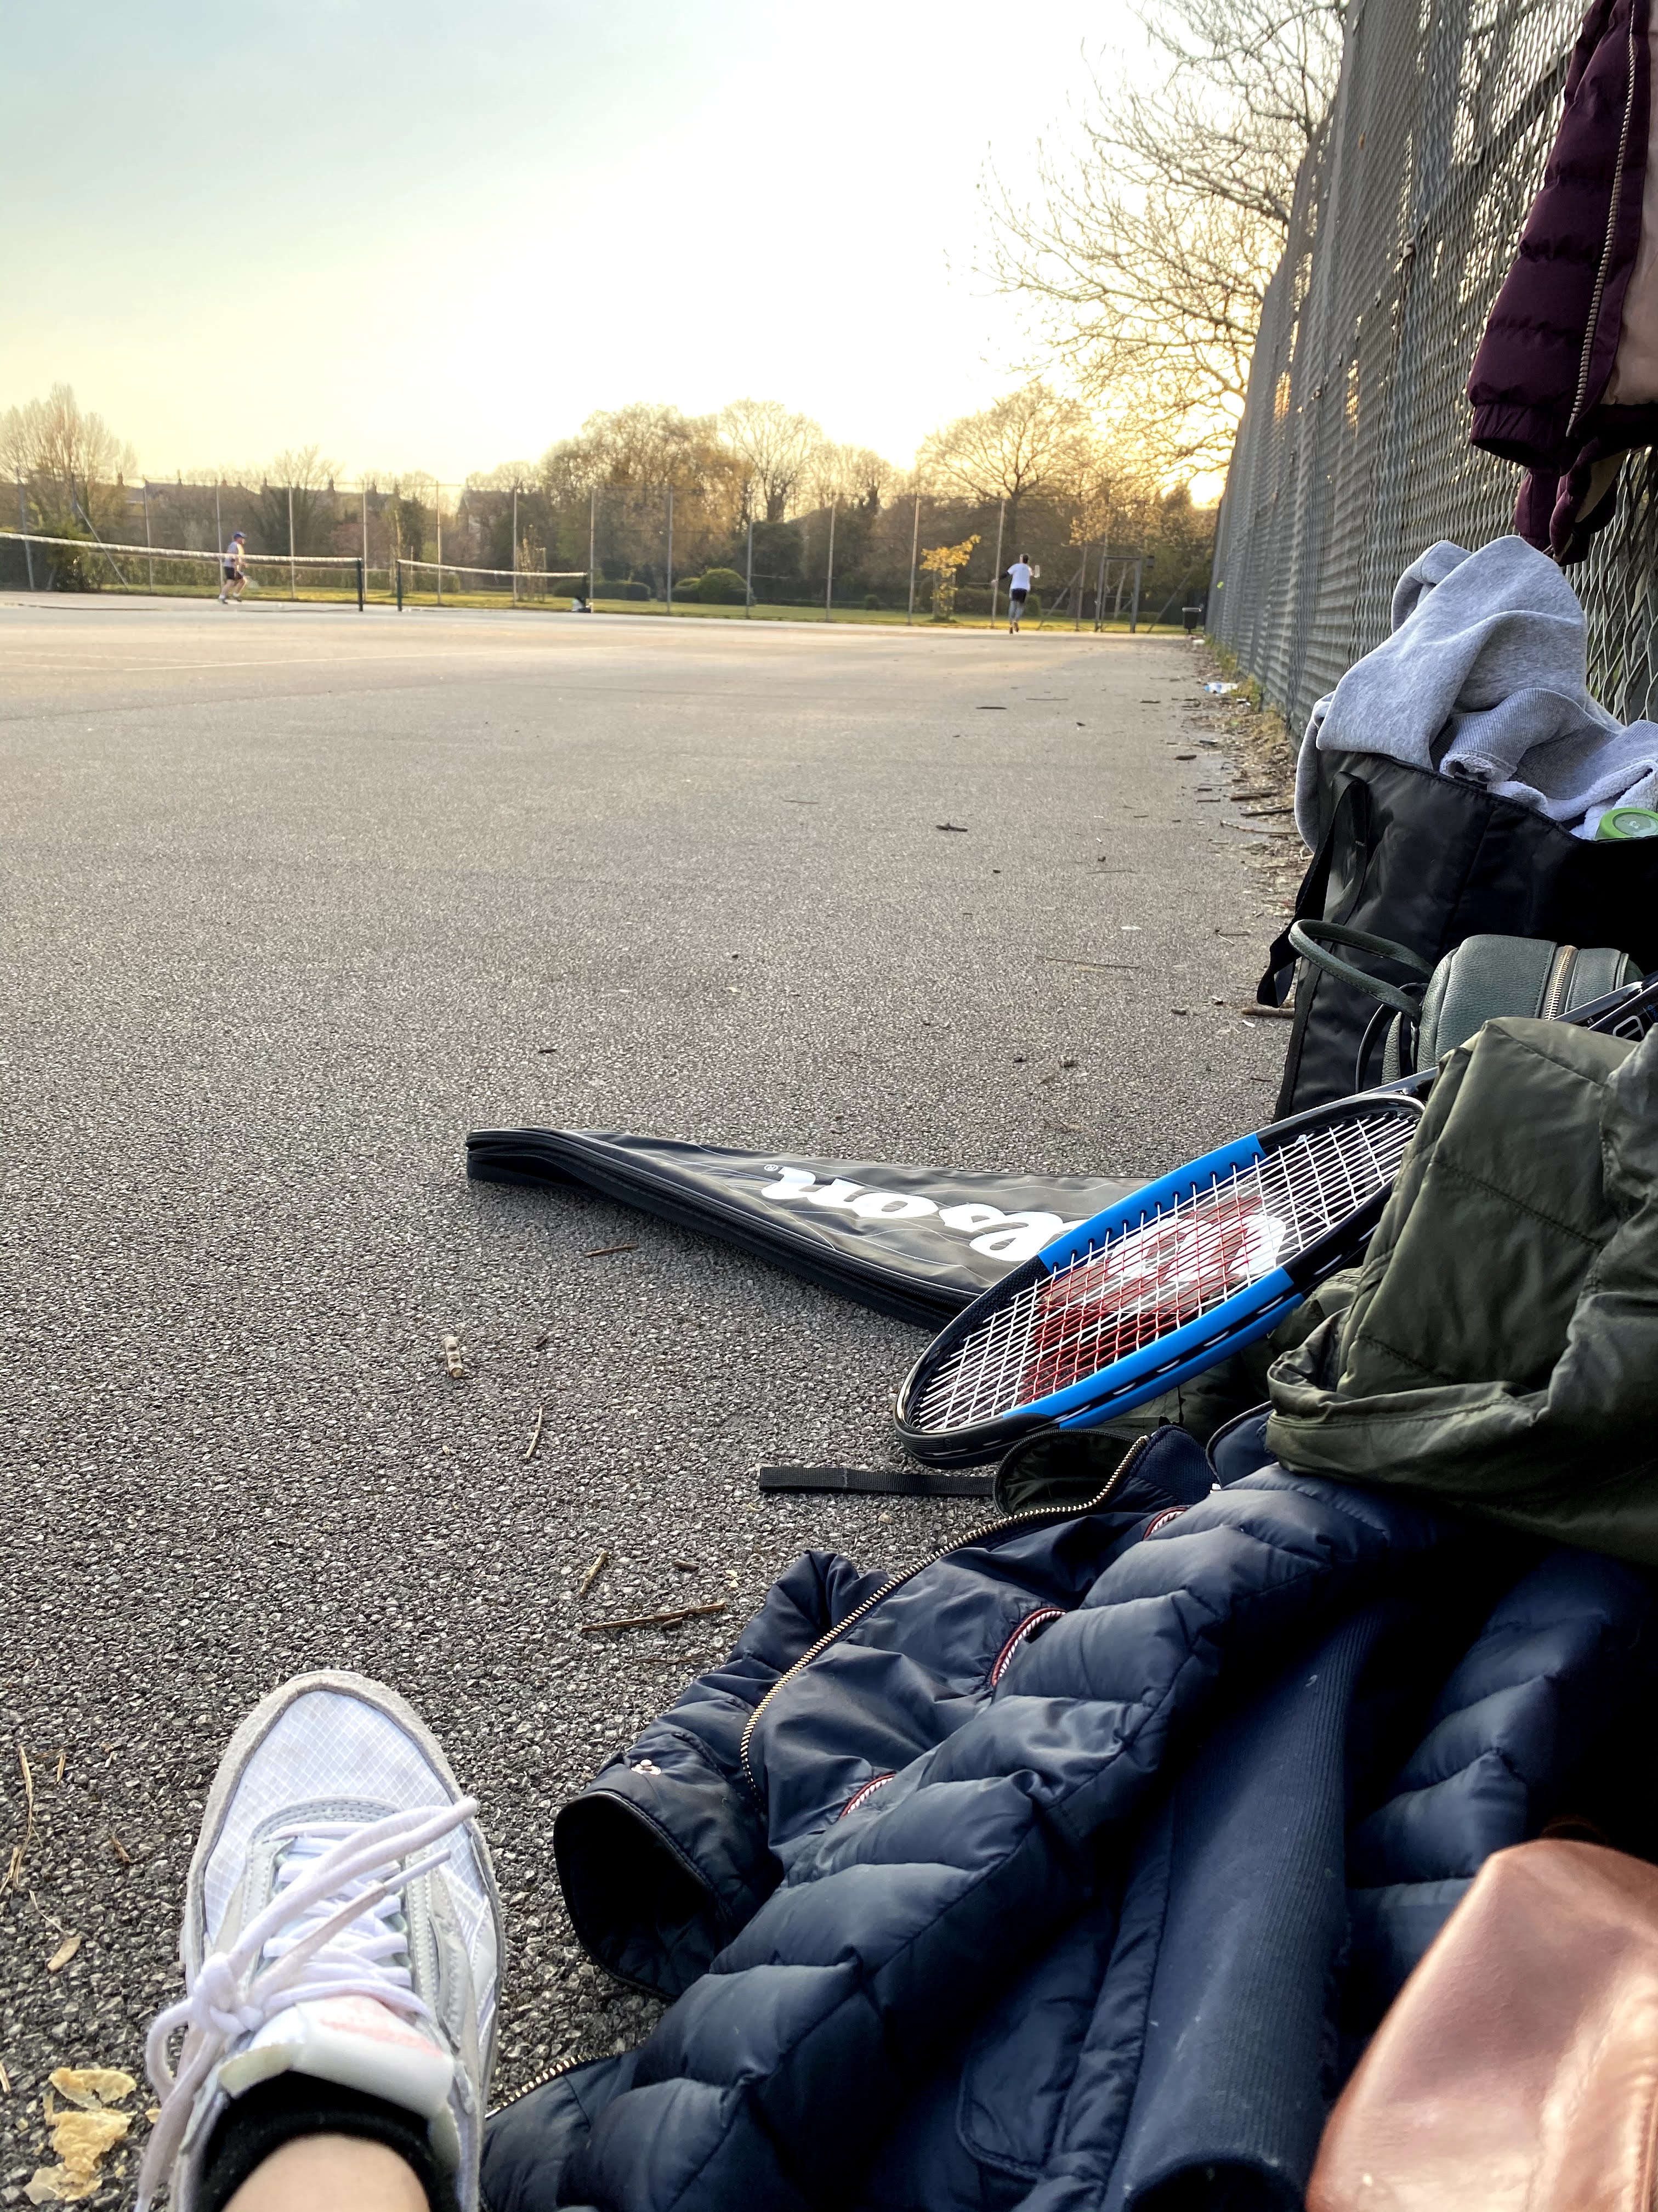
Thank you

